Slide 1
SOAP Web Services
Presenter Name
Presentation Date
Notes:
This template can be used as a starter file for presenting training materials in a group setting.
Sections
Right-click on a slide to add sections. Sections can help to organize your slides or facilitate collaboration between multiple authors.
Notes
Use the Notes section for delivery notes or to provide additional details for the audience. View these notes in Presentation View during your presentation.
Keep in mind the font size (important for accessibility, visibility, videotaping, and online production)
Coordinated colors
Pay particular attention to the graphs, charts, and text boxes.
Consider that attendees will print in black and white or grayscale. Run a test print to make sure your colors work when printed in pure black and white and grayscale.
Graphics, tables, and graphs
Keep it simple: If possible, use consistent, non-distracting styles and colors.
Label all graphs and tables.

Slide 2
What IS SOAP?
SOAP stands for Simple Object Access Protocol. It is a XML-based protocol for accessing web services.
SOAP is XML based protocol. It is platform independent and language independent. By using SOAP, you will be able to interact with other programming language applications.
Notes:
Give a brief overview of the presentation. Describe the major focus of the presentation and why it is important.
Introduce each of the major topics.
To provide a road map for the audience, you can repeat this Overview slide throughout the presentation, highlighting the particular topic you will discuss next.

Slide 3
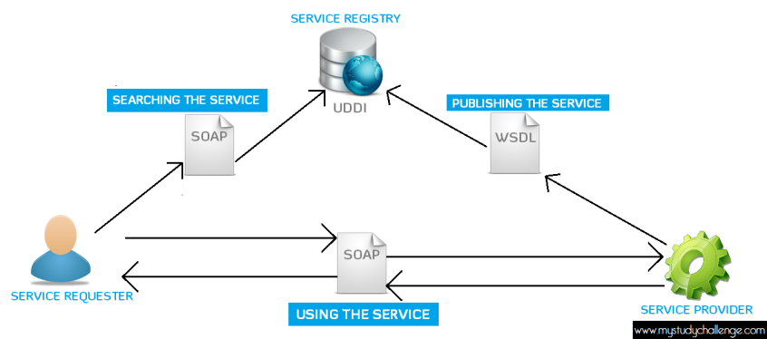
Architecture of SOAP Web Services

Slide 4

WSDL And UDDI
Notes:
This is another option for an Overview slides using transitions.

Slide 5
What is WSDL?
WSDL stands for Web Services Description Language. It is the standard format for describing a web service.
WSDL definitions describe how to access a web service and what operations it will perform.
WSDL is an integral part of Universal Description, Discovery, and Integration (UDDI), an XML-based worldwide business registry.
WSDL is the language that UDDI uses.
WSDL is pronounced as 'wiz-dull' and spelled out as 'W-S-D-L'.

Slide 6
What is UDDI?
UDDI is an XML-based standard for describing, publishing, and finding Web services.
UDDI stands for Universal Description, Discovery, and Integration.
UDDI is a specification for a distributed registry of web services.
UDDI is a platform-independent, open framework.
UDDI uses Web Service Definition Language(WSDL) to describe interfaces to web services.
UDDI is seen with SOAP and WSDL as one of the three foundation standards of web services.

Slide 7
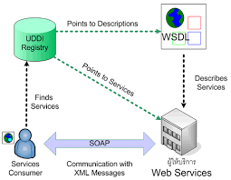
SOAP Web Service

Slide 8
Conclusion

Slide 9
Conclusion
Refer the below document for a sample SOAP web service creation.

